Slide 1

How to remove folders - os.rmdir, os.removedirs, and shuti.rmtree

Slide 2
Reference
Youtube
Code

Slide 3
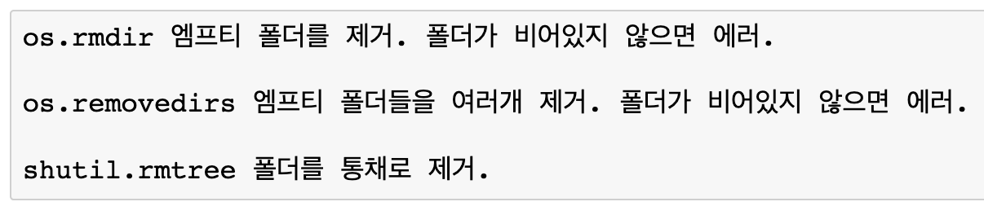

Slide 4
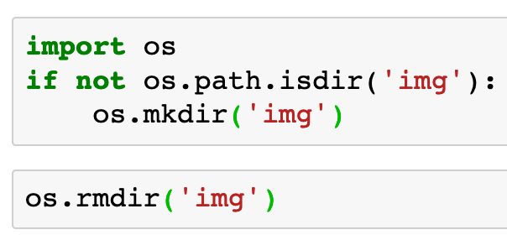

Slide 5
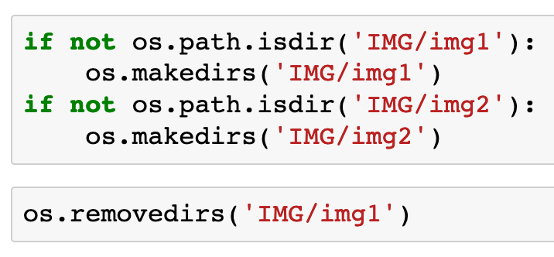

Slide 6
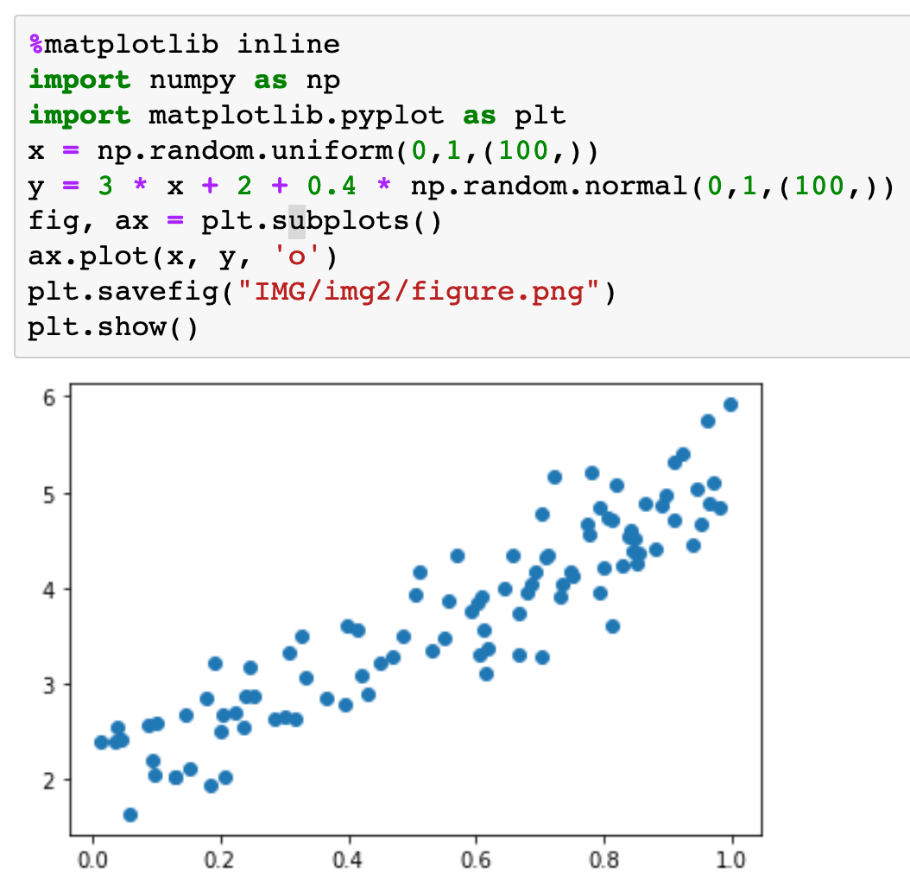

Slide 7
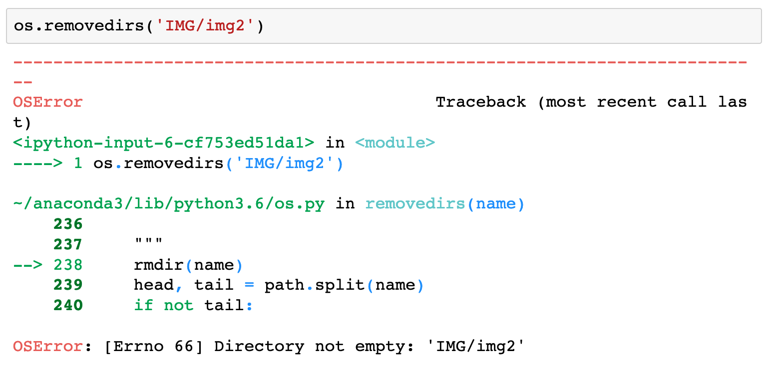

Slide 8
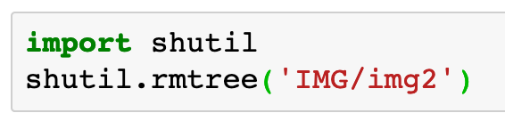

Slide 9
Now
Let’s Play with Code

